Slide 1
Lecture 21
SQA
BSCS(Software Engineering-I) SZABIST-Islamabad

Slide 2
What is Quality & Quality Mgt?
Quality – developed product meets it’s specification.
Quality Management – ensuring that required level of
product quality is achieved.
Defining procedures and standards
Applying procedures and standards to the product and process
Checking that procedures are followed
Collecting and analyzing various quality data
BSCS(Software Engineering-I) SZABIST-Islamabad

Slide 3
What is SQA?
SQA includes all 4 elements…
Software Quality Assurance – establishment of network of organizational procedures and standards leading to high-quality software
Software Quality Planning – selection of appropriate procedures and standards from this framework and adaptation of these to specific software project
Software Quality Control – definition and enactment of processes that ensure that project quality procedures and standards are being followed by the software development team
Software Quality Metrics – collecting and analyzing quality data to predict and control quality of the software product being developed
BSCS(Software Engineering-I) SZABIST-Islamabad

Slide 4
Standards
Standards provide encapsulation of best, or at least most appropriate, practice
Standards provide a framework around which the quality assurance process may be implemented
Standards assist in continuity of work when it’s carried out by different people throughout the software product lifecycle
Standards should not be avoided. If they are too extensive for the task at hand, then they should be tailored.
BSCS(Software Engineering-I) SZABIST-Islamabad

Slide 5
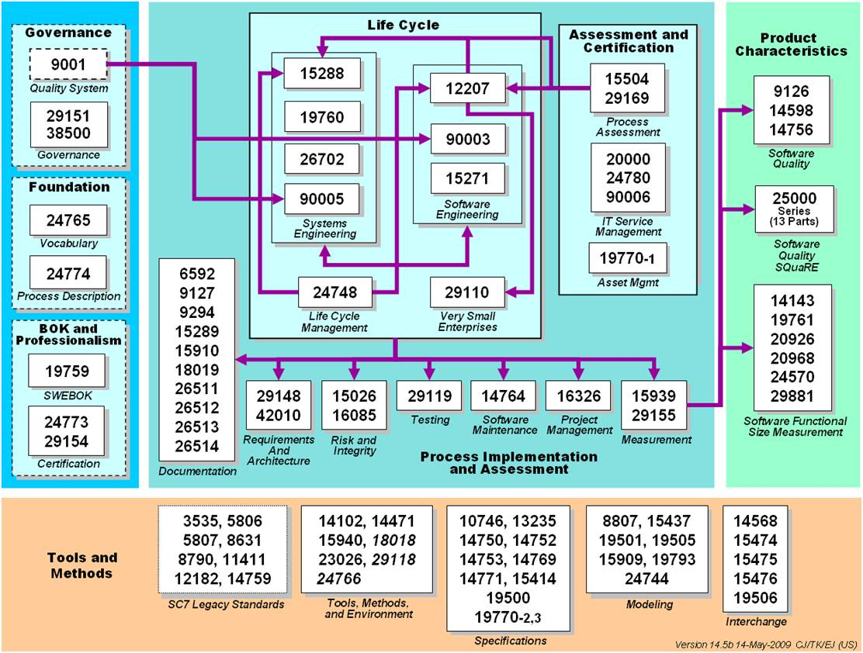
ISO Standards Collection
BSCS(Software Engineering-I) SZABIST-Islamabad

Slide 6
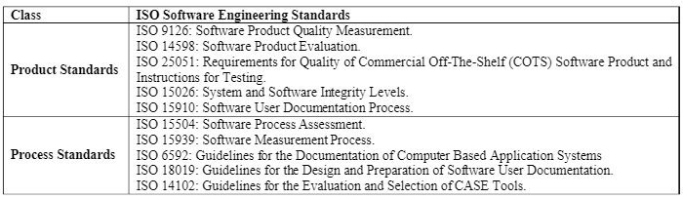
List of the Software Engineering ISO Standards
BSCS(Software Engineering-I) SZABIST-Islamabad

Slide 7
Methods of Software Quality Control
SQC involves overseeing the software development process to ensure that the procedures and STD’s are being followed
The following activities constitute SQC:
Reviews: (reviewing documents and procedures) this is the most widely used method of validating the quality of processes and products. SQE is responsible for writing Quality Engineering Records (QERs) documenting their participation in these reviews.
Tests: (end-result verifications of products.) These verifications are conducted after the software has been developed. Test procedures are followed during conduct of these activities. SQE is responsible for keeping the logs and some times for writing the test report.
Quality Audits: (in-process verifications of processes.) These audits are conducted periodically (twice a month) to assess compliance to the process STD’s.
BSCS(Software Engineering-I) SZABIST-Islamabad

Slide 8
1. Quality Reviews Techniques
Peer reviews
Walkthroughs
Inspections
BSCS(Software Engineering-I) SZABIST-Islamabad

Slide 9
Peer reviews
Peer reviews - reviews of processes and products by groups of people.
These reviews require pre-review preparation by all participants.
This type of review requires participation of the SQE, moderator, recorder, author(s), and one or more critical reviewers.
All issues found during these reviews are documented.
BSCS(Software Engineering-I) SZABIST-Islamabad

Slide 10
Walkthrough
A formal, scheduled activity where a designer presents a design and traces the values of sample data through the design and a selected group of peers evaluates the technical aspects of the design.
Or
reviews of products by groups of people mostly without preparation.
For example a requirements traceability review is a walkthrough. It involves tracing a requirement from customer requirements to the test procedures.
All issues found during these reviews are documented.
BSCS(Software Engineering-I) SZABIST-Islamabad

Slide 11
Inspection
A formal, scheduled activity where a specialist checks a document for conformity with established standards (often corporate standards)
reviews of products by individuals. These reviews involve people reviewing products by themselves (not in a group) and then submitting their comments to the author(s).
The issues found during these reviews are treated in informal manner.
BSCS(Software Engineering-I) SZABIST-Islamabad

Slide 12
2. Tests
Engineering Dry-run - test conducted by engineering without SQE. These tests include Unit Tests and engineering dry-runs of the formal tests. These engineering dry-runs are used to verify correctness and completeness of the test procedures. Also, this is the final engineering verification of the end-product before sell-off to SQE. All issues found during these tests are documented on STR(sw tst rpt) forms.
SQE Dry-run - test conducted by SQE. These tests include PQT, FAT and SAT dry-runs. These tests are used to verify the end-product before the formal test with the customer. An SQE is sometimes responsible for writing the test report. All issues found during these tests are documented on STR forms.
TFR - test conducted as “RFR - run-for-record” with the SQE and the customer. These tests include FAT and SAT. These tests are conducted to sell the end-product off to the customer. SQE is present at all such tests. All issues found during these tests are documented on STR forms.
BSCS(Software Engineering-I) SZABIST-Islamabad

Slide 13
3. Quality Audits
SQE Audits - audits conducted by SQE to verify that the process STD’s are being followed.
Examples of these audits are Configuration Control, and Software Engineering Management.
All findings for these audits are documented on QER(quality estimation review) forms. The results of the audits are distributed to the next level of management (above project level). If the issue(s) are not fixed then the findings are elevated to upper management.
Independent Audits - audits conducted by ISO generalists or other independent entities to verify that the process STD’s are being followed. These audits are usually conducted on a division/facility level. The results of these audits are distributed to upper management.
BSCS(Software Engineering-I) SZABIST-Islamabad

Slide 14
Metrics Collection
Software measurement - the process of deriving a numeric value for some attribute of a software product or a software process. Comparison of these values to each other and to STD’s allows drawing conclusions about the quality of software products or the process.
    Product Metrics (size, complexity, design features etc)
    Process Metrics (efficiency, throughput etc)
    Project Metrics (project plan)
BSCS(Software Engineering-I) SZABIST-Islamabad

